Slide 1
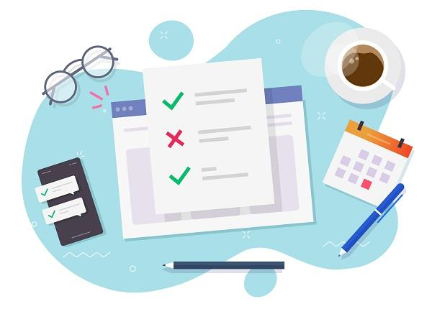
Let’s go shopping!
Notes:
To get an editable version of this presentation:
1. Click File > Make a copy > Entire presentation
OR
2. Click File > Download > Microsoft Powerpoint

Slide 2
GRAMMAR
Present perfect . Already, just,yet
INTRO VIDEO: Please watch the video
Pamela please add a link to The Present Perfect Simple and Continuous video file

Slide 3
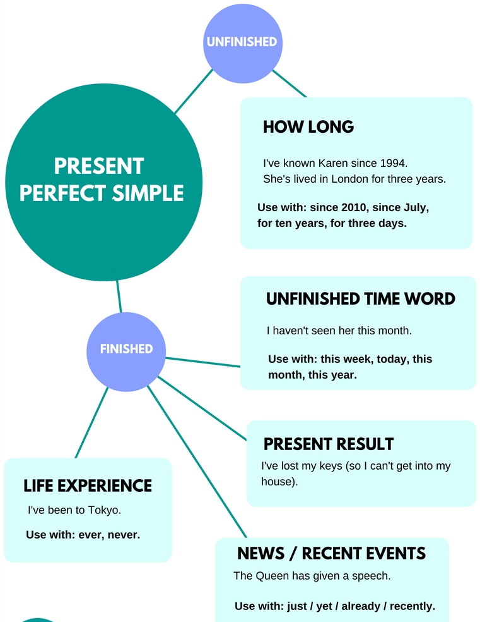

Slide 4
Read the dialogue between a group of friends preparing a surprise birthday party and choose correct options in the rules below.
Sarah: OK, guys we need to check what we have already done. Mike, we’ll
start with you. Have you picked up the cake yet?
Mike: Oh, come on Sarah, I’ve just come back from the bakery.
Sarah: OK, OK, how about decorations?
Mike: Houston, we have a problem. Unfortunately, I haven’t bought the
balloons yet as the shop assistant told me they were waiting for a delivery that night. I hope to get them in the morning.
Sarah: Fingers crossed then. Bob, is the food ready?
Bob: Don’t worry, I’ve already started preparing some casseroles and
savoury tarts. Tomorrow, I’ll prepare some salads and finger food.
Sarah: Great! It seems like we have everything under control. Let me check
my to-do list. Oh shoot! I forgot about the present! I haven’t ordered it yet! I have to run now! By the way, good job guys!

Slide 5
We use already when we want to say that something happened later/sooner than we expected, or before/after the present time.
The meaning of just is: a very short time ago/quickly.
Yet means until the present time and can only be used in
questions/affirmative sentences/negative sentences.

Slide 6
Answers:
We use already when we want to say that something happened later/sooner than we expected, or before/after the present time.
The meaning of just is: a very short time ago/quickly.
Yet means until the present time and can only be used in questions/affirmative sentences/negative sentences.
sooner
before
a very short time ago
questions and negative sentences

Slide 7
ASSESSMENT: Complete these short dialogues using just, already, or yet, and your own ideas.
I have ____ walked in the door. Can I call you later?
JUST
YET
A: You have 20 minutes to finish
B: I have finished ______
ALREADY
JUST
I have……………………………… completed 30 pages of my thesis.
ALREADY
YET
A: Have you been to New York?
B: No, I haven’t been _____.
YET
JUST
A: Have you called Mary?
B: Yes, I have …………… called her
YET
JUST

Slide 8
USE OF ENGLISH
News stories
Click directly on the Assessment Tab

Slide 9
ASSESSMENT: Complete the following breaking news paragraphs with the options below
January 2020
The United States of America (detect) has detected its first case of COVID-19. Officials believe it (start) started when a man from Washington (travel) travelled from Wuhan, China to the US.
February 2020
The Trump impeachment trial (start) has started. The White House (charge) charged him with abuse of power and obstruction of congress.
March 2020
The WHO (declare) has declared COVID-19 a pandemic. Health officials (warn) warned that the virus might infect up to 70% of the world's population.

Slide 10
May 2020
Protesters (gather) have gathered across the country to fight inequality. The wrongful death of George Floyd (spark) sparked this outrage.
August 2020
Hurricane Laura (hit) has hit the Louisiana Gulf Coast. Officials say that the hurricane (strike) struck the area last night around midnight.
November 2020
Joe Biden (win) has won the 2020 election. President Trump (disagree) disagreed and (try) tried to overturn the result.

Slide 11
VOCABULARY
Shopping
Click directly on the Assessment Tab

Slide 12
Complete the sentences with the verbs in the box to create phrases related to shopping (5p). [part 1/2]
spend place make (x2) use visit change add shop get
You can always return a product bought online if you ……………… your mind or if it doesn’t fit you.
It is easy to …………………………… around online and find the best deal very quickly.
A lot of people ……………………………… too much money on clothes or gadgets.
If you want to ……………………………… an order, click the green button and make the payment.
If you want to ………………………………. a complaint about a product you bought at our store, complete this form and send it to customerservice@acme.com

Slide 13
Complete the sentences with the verbs in the box to create phrases related to shopping. [part 2/2]
spend place make (x2) use visit change add shop get
How many stores do you usually ……………………………… when you go shopping?
Enter your credit or debit card details and any other information required, then click “confirm card details” to ……………………………… a payment.
Once you have made a decision, simply select quantity and ……………………………… the product to the cart.
You can ……………… coupons to save money on everyday things such as your grocery shopping.
We promise you a 30-day satisfaction guarantee, which means that you can return the product within 30 days and …………………………… a full refund.

Slide 14
Answers [part1/2]
You can always return a product bought online if you …………………………… your mind or if it doesn’t fit you.
It is easy to …………………………… around online and find the best deal very fast.
A lot of people ………………………… too much money on clothes or gadgets.
If you want to ………………………… an order, click the green button and make the payment.
If you want to ………………………… a complaint about a product you bought at our store, complete this form and send it to customerservice@acme.com.
change
shop
spend
place
make

Slide 15
Answers [part 2/2]
How many stores do you usually …………………………… when you go shopping?
Enter your credit or debit card details and any other information required, then click “confirm card details” to ………………………… a payment.
Once you have made a decision, simply select quantity and …………………………… the product to the cart.
You can …………………………… coupons to save money on everyday things such as your grocery shopping.
We promise you a 30-day satisfaction guarantee, which means that you can return the product within 30 days and …………………………. a full refund.
visit
make
add
use
get

Slide 16
READING Singles’ Day shopping spree smashes record in China
Click directly on the Assessment Tab

Slide 17
Read the text about the Singles’ Day and answer the questions.
Why and where was Singles’ Day invented?
Why is it celebrated on November 11th?
What is Singles’ Day similar to nowadays?
Singles' Day always falls on November 11th because the date 11/11 represents four ones, or four singles, standing together. It was originally called "Bachelor's Day" and the celebration began among students at China's Nanjing University around 1993 as a sort of anti-Valentine's Day. Interestingly, Singles' Day has become the largest online shopping day in the world. The holiday became an important commercial event in China during the first decade of the 21st century when the Chinese e-commerce giant Alibaba offered products with big discounts on its platform for 24 hours, starting at midnight on Nov 11, 2009. Since then, Singles' Day has become a super shopping day, like the post-Thanksgiving Black Friday and Cyber Monday in the U.S.
Adapted from Investopedia.com
In China during the first decade of the 21st century
b. It represents four ones, or four singles, standing together.
c. Black Friday and Cyber Monday in the U.S.

Slide 18
LISTENING Singles’ Day shopping spree smashes record in China
Click directly on the Assessment Tab

Slide 19
Watch the video and match the figures and dates with what they refer to (8p). Pamela please add the link to Singles Day shopping video file
the 1990s
November, 11
18 billion
650 million
258 thousand
orders placed during Singles' Day last year (2016)
time when the Singles' Day started
the date of Singles' Day
tonnes of CO2 produced during Singles' Day 2016
dollars spent during Singles' Day in 2016

Slide 20
Let’s check the answers.
orders placed during Singles' Day last year (2016)
time when the Singles' Day started
the date of Singles' Day
tonnes of CO2 produced during Singles' Day 2016
dollars spent during Singles' Day in 2016
the 1990s
November, 11
18 billion
650 million
258 thousand

Slide 21
PROJECT
Where do you buy things ?

Slide 22
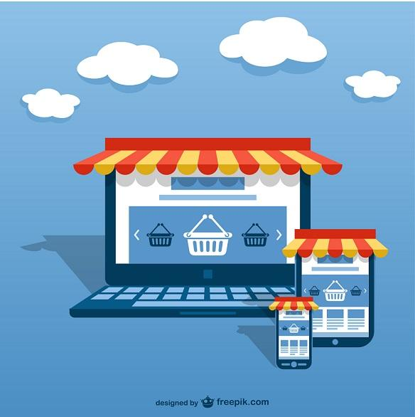
Do you shop online? Do you go to the shops? Maybe both? Why/ Why not? In your Journal in Public mode, write about the benefits and drawbacks of both ways of shopping.
Please use the title in your Journal: “LET’S GO SHOPPING”. Prepare your answer carefully and do not copy and paste (plagiarize), use your own words! Your piece of work will not be graded but it could be discussed with your teacher in your next DBA which will be graded! Minimum 75 words
Online shopping
Advantages
Disadvantages
Traditional shopping
Advantages
Disadvantages

