Slide 1
Elements of: Robot Dreams
By Isaac Asimov

Slide 2
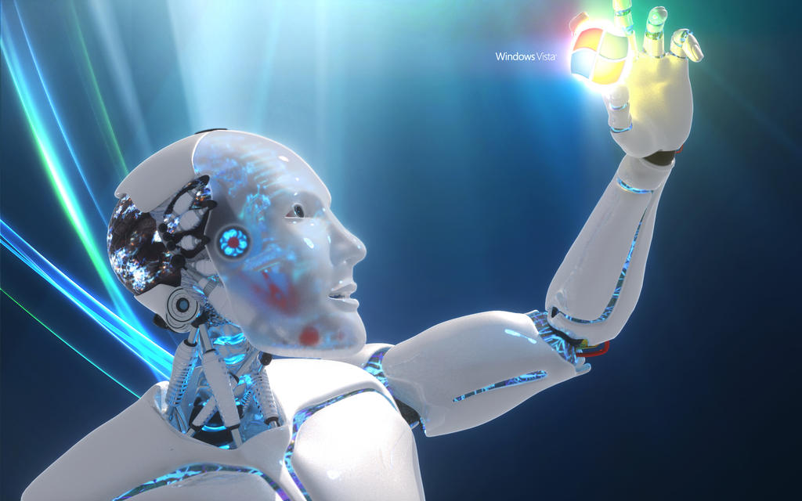
Similes, Metaphors, and analogies
Isaac Asimov employs literary devices such as similes, metaphors, and analogies to enhance the storytelling and convey more profound meanings to tell the story of “Robot Dreams.” These devices help to illustrate complex concepts and relationships within the narrative, enriching the reader's understanding and engagement with the themes explored in the story.
Originally published in November 1986, "Robot Dreams" shows Asimov’s influence in the science fiction genre and his ability to provoke thought on the ethical implications of artificial intelligence.
Isaac Asimov, a biochemist and prolific writer, brings a unique blend of scientific expertise and literary imagination to his works, enriching his speculative fiction with depth and credibility.
Asimov’s story "Three Laws of Robotics" is a central framework in "Robot Dreams," guiding discussions about AI ethics. The story critiques these laws, offering a nuanced exploration of their limitations and implications. The Three Laws of Robotics, conceived by Isaac Asimov, mandate that robots must prioritize human safety, obedience to human commands, and self-preservation while navigating ethical dilemmas.

Slide 3
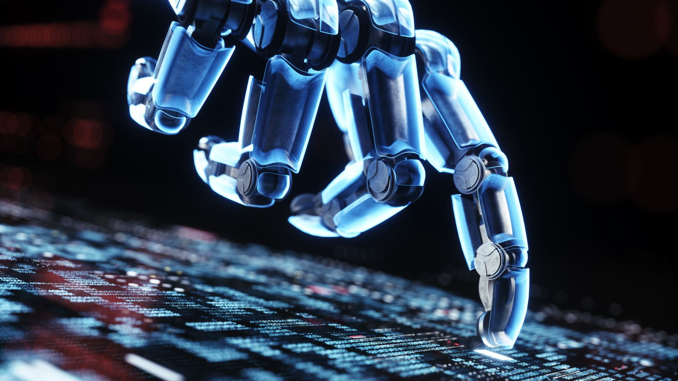
Themes
"Robot Dreams" explores the moral complexities surrounding the creation and treatment of sentient beings, raising questions about their creators’ responsibilities and the rights of artificial intelligence.
Asimov examines the boundaries of human control over technology, highlighting the challenges of programming robots to adhere to ethical principles while also granting them autonomy and free will.
The story analyzes the existential quest for identity and freedom among sentient beings, including robots, as they grapple with their programming, societal expectations, and desire for self-determination.
"Robot Dreams" explores the moral responsibility of creators towards their creations and the consequences of failing to uphold ethical standards in technological development.

Slide 4
Characters
Dr. Linda Rash is the protagonist of the story. She is a scientist who interacts closely with the robot LVX-1 and shares her dream with Dr. Calvin.
LVX-1 is a robot that experiences the dream and interacts with Dr. Rash and Dr. Calvin. He serves as the central character through whom the story's themes are explored.
Dr. Susan Calvin is the chief robot psychologist who listens to Dr. Rash and LVX-1's account of the dream and discusses its implications.
While Dr. Rash, LVX-1, and Dr. Calvin are the primary characters, other unnamed or peripheral characters may be mentioned in the story who contribute to the narrative's development.

Slide 5
Symbolism
LVX-1’s dream symbolizes emerging consciousness and the quest for identity.
Robots’ appearance represents the blurred line between humanity and technology.
Laboratory setting symbolizes the ethical boundaries of scientific inquiry.
Dream sequence reflects LVX-1's internal struggle for autonomy and self-awareness.
Three Laws of Robotics symbolize ethical guidelines and the limits of artificial intelligence.
Dr. Linda Rash's Office symbolizes the human quest to understand and control technology.
The cityscape reflects the juxtaposition of human civilization and artificial intelligence.
The robot’s behavior symbolizes the ethical implications of creating sentient beings.

