Slide 1
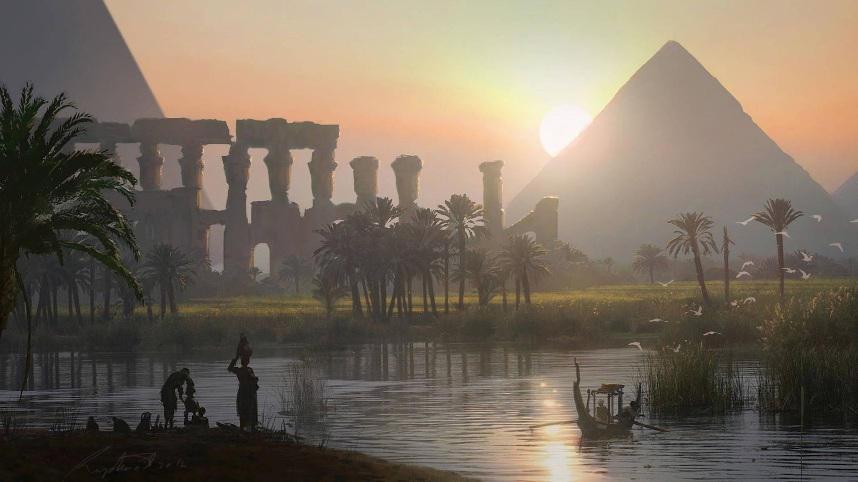
Ancient Egypt Expedition
Mummification

Slide 2
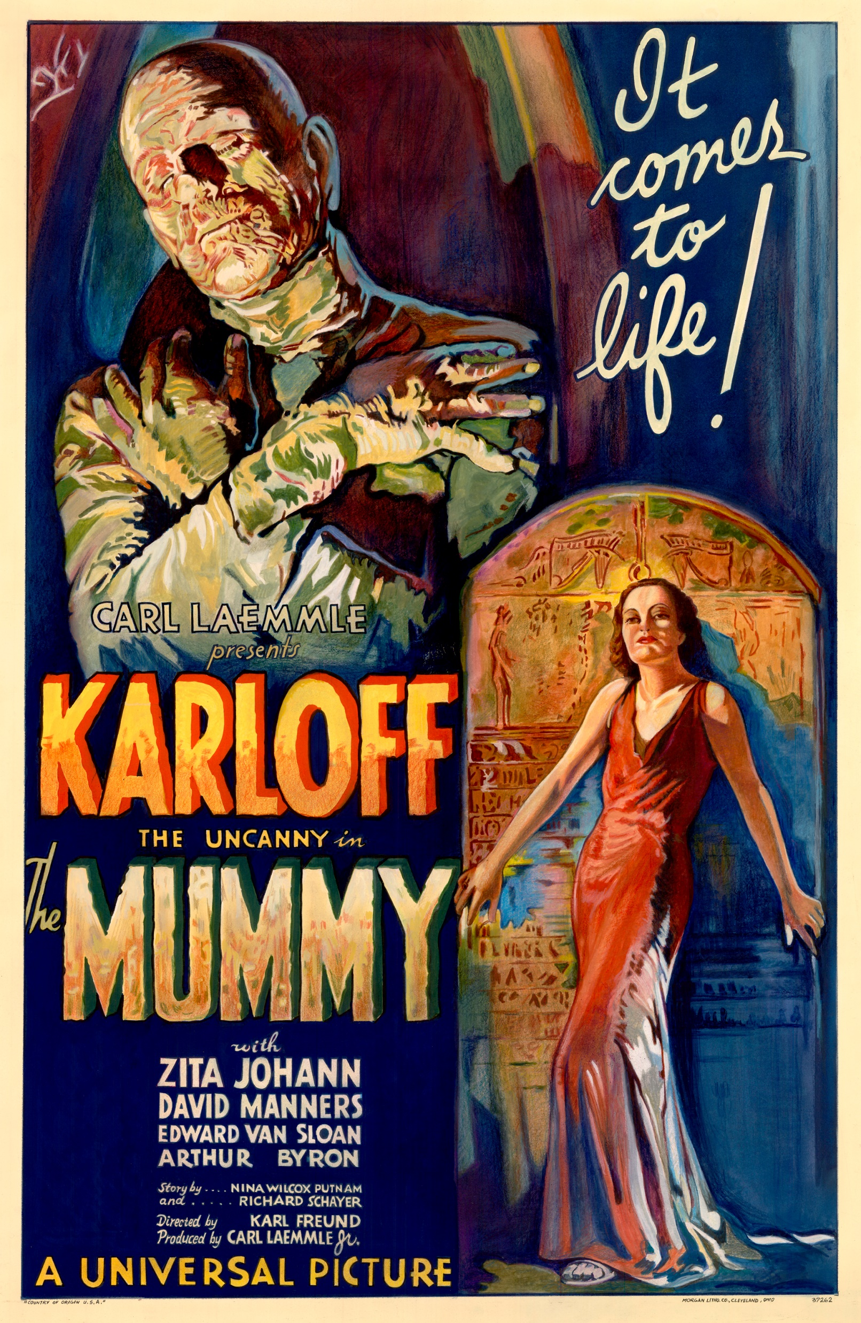
A Short History of Mummification
Ancient Egypt is famous for many things. Mummies are one of those. However, mummification is not something that Egyptians always did.
This practice was developed over centuries, and only intentionally began around 2600 BC, approximately 1000 years after the construction of the Great Pyramid of Giza.
The process was perfected over time and the quality of the mummies varied, depending on the individuals who performed the ritual and the amount of money that was paid.
It was most common among important individuals such as government officials and pharaohs, but was also practiced among the common people, who would purchase mummification – much like you might make preparations for your death today by ordering a tombstone at a funeral home.

Slide 3
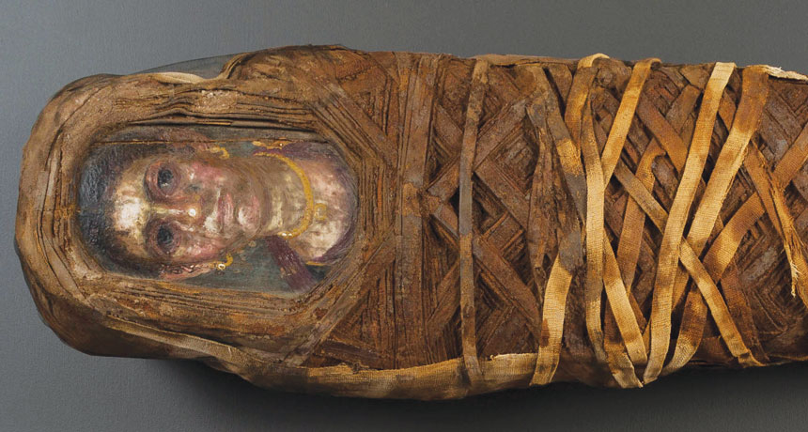
Beginning of the Process
Each of you has a nice fresh corpse in front of you. These are dignitaries which we will need to preserve for their journey to the afterlife! In order do so, we will need to remove those parts of the body which can lead to deterioration.
Step 1: Experiencing Brain Drain
The first thing we need to do is remove the brain. In Ancient Egypt, this was done by inserting a metal pick through the nose and swirling it around until the brain liquified. Feel free to use whatever tool you can find at your disposal to mimic this process!

Slide 4
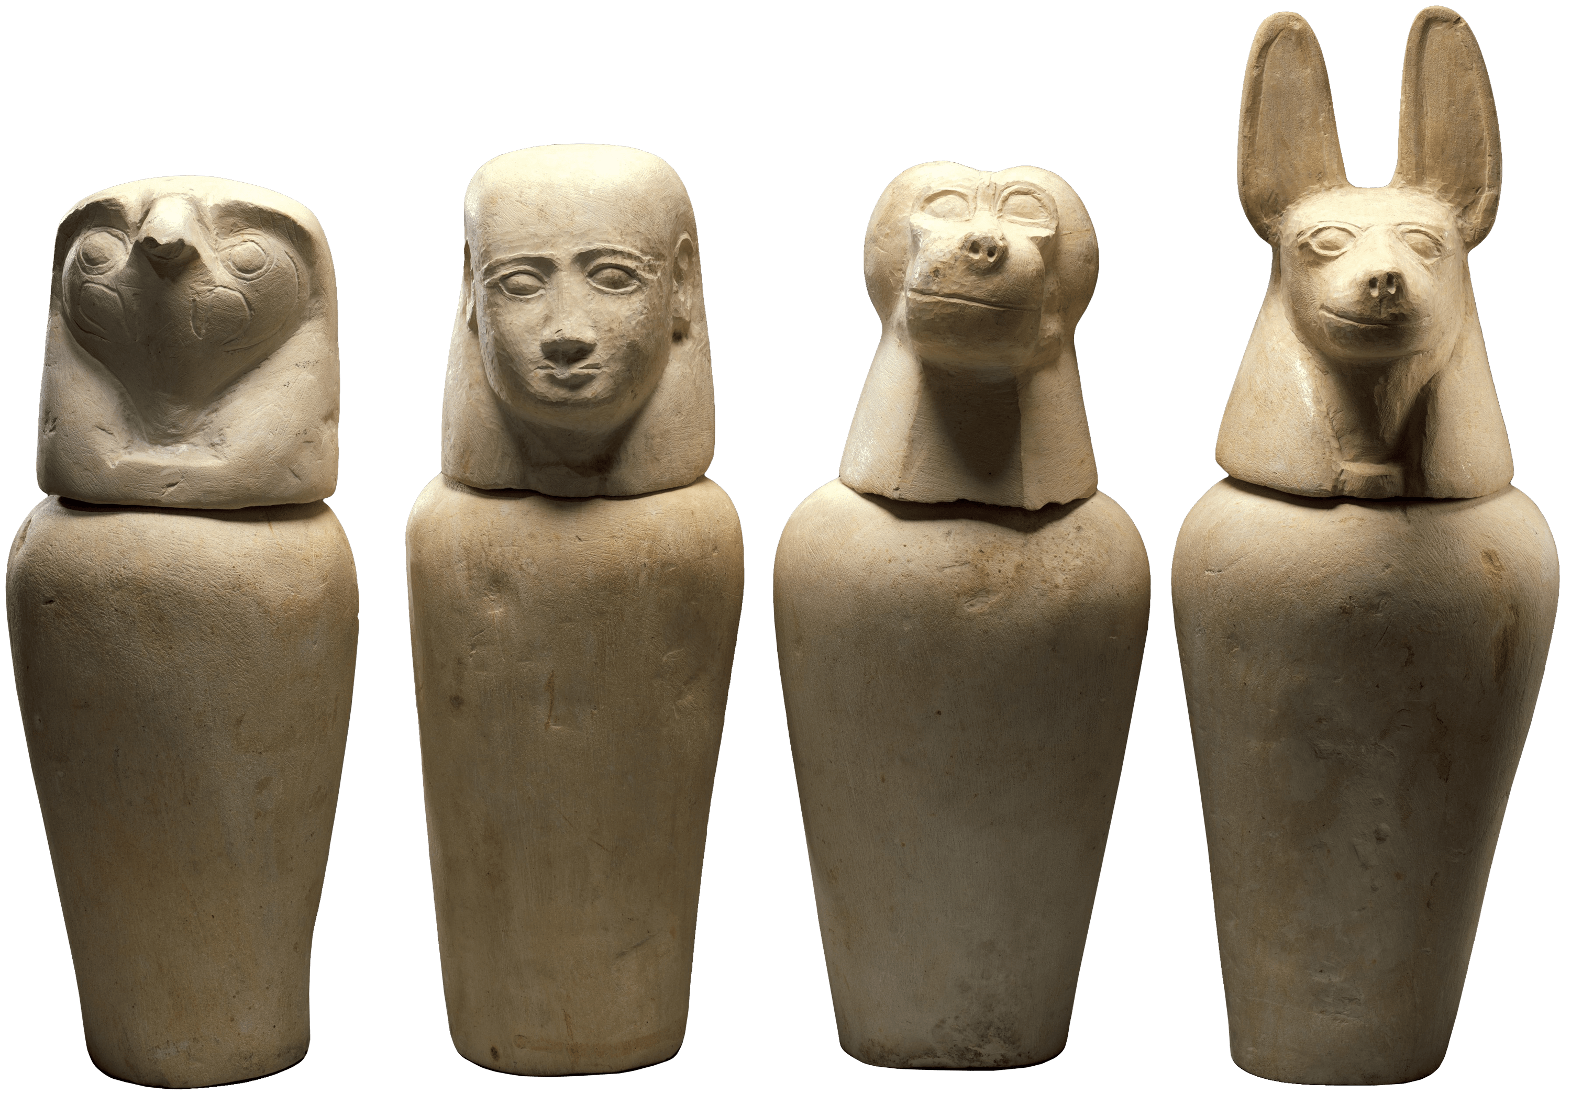
Removing and Preserving Organs
Now that we have the brain removed, we can continue with the more “mindless” parts of the mummification process.
Step 2: Remove the Internal Organs
Internal organs are breeding grounds for bacteria that can quickly begin to decompose the body after death. By removing these organs, we can prevent bacteria from affecting the body. Don’t accidentally remove anything structural. We want our mummy to be able to stand up for himself in the afterlife!
Step 3: Separate the Significant Organs
As Ancient Egyptians, we believe that the liver, lungs, intestines, and stomach serve a special purpose. We will preserve these organs by placing them in our canopic jars so that our mummy can reuse them in the after life!

Slide 5
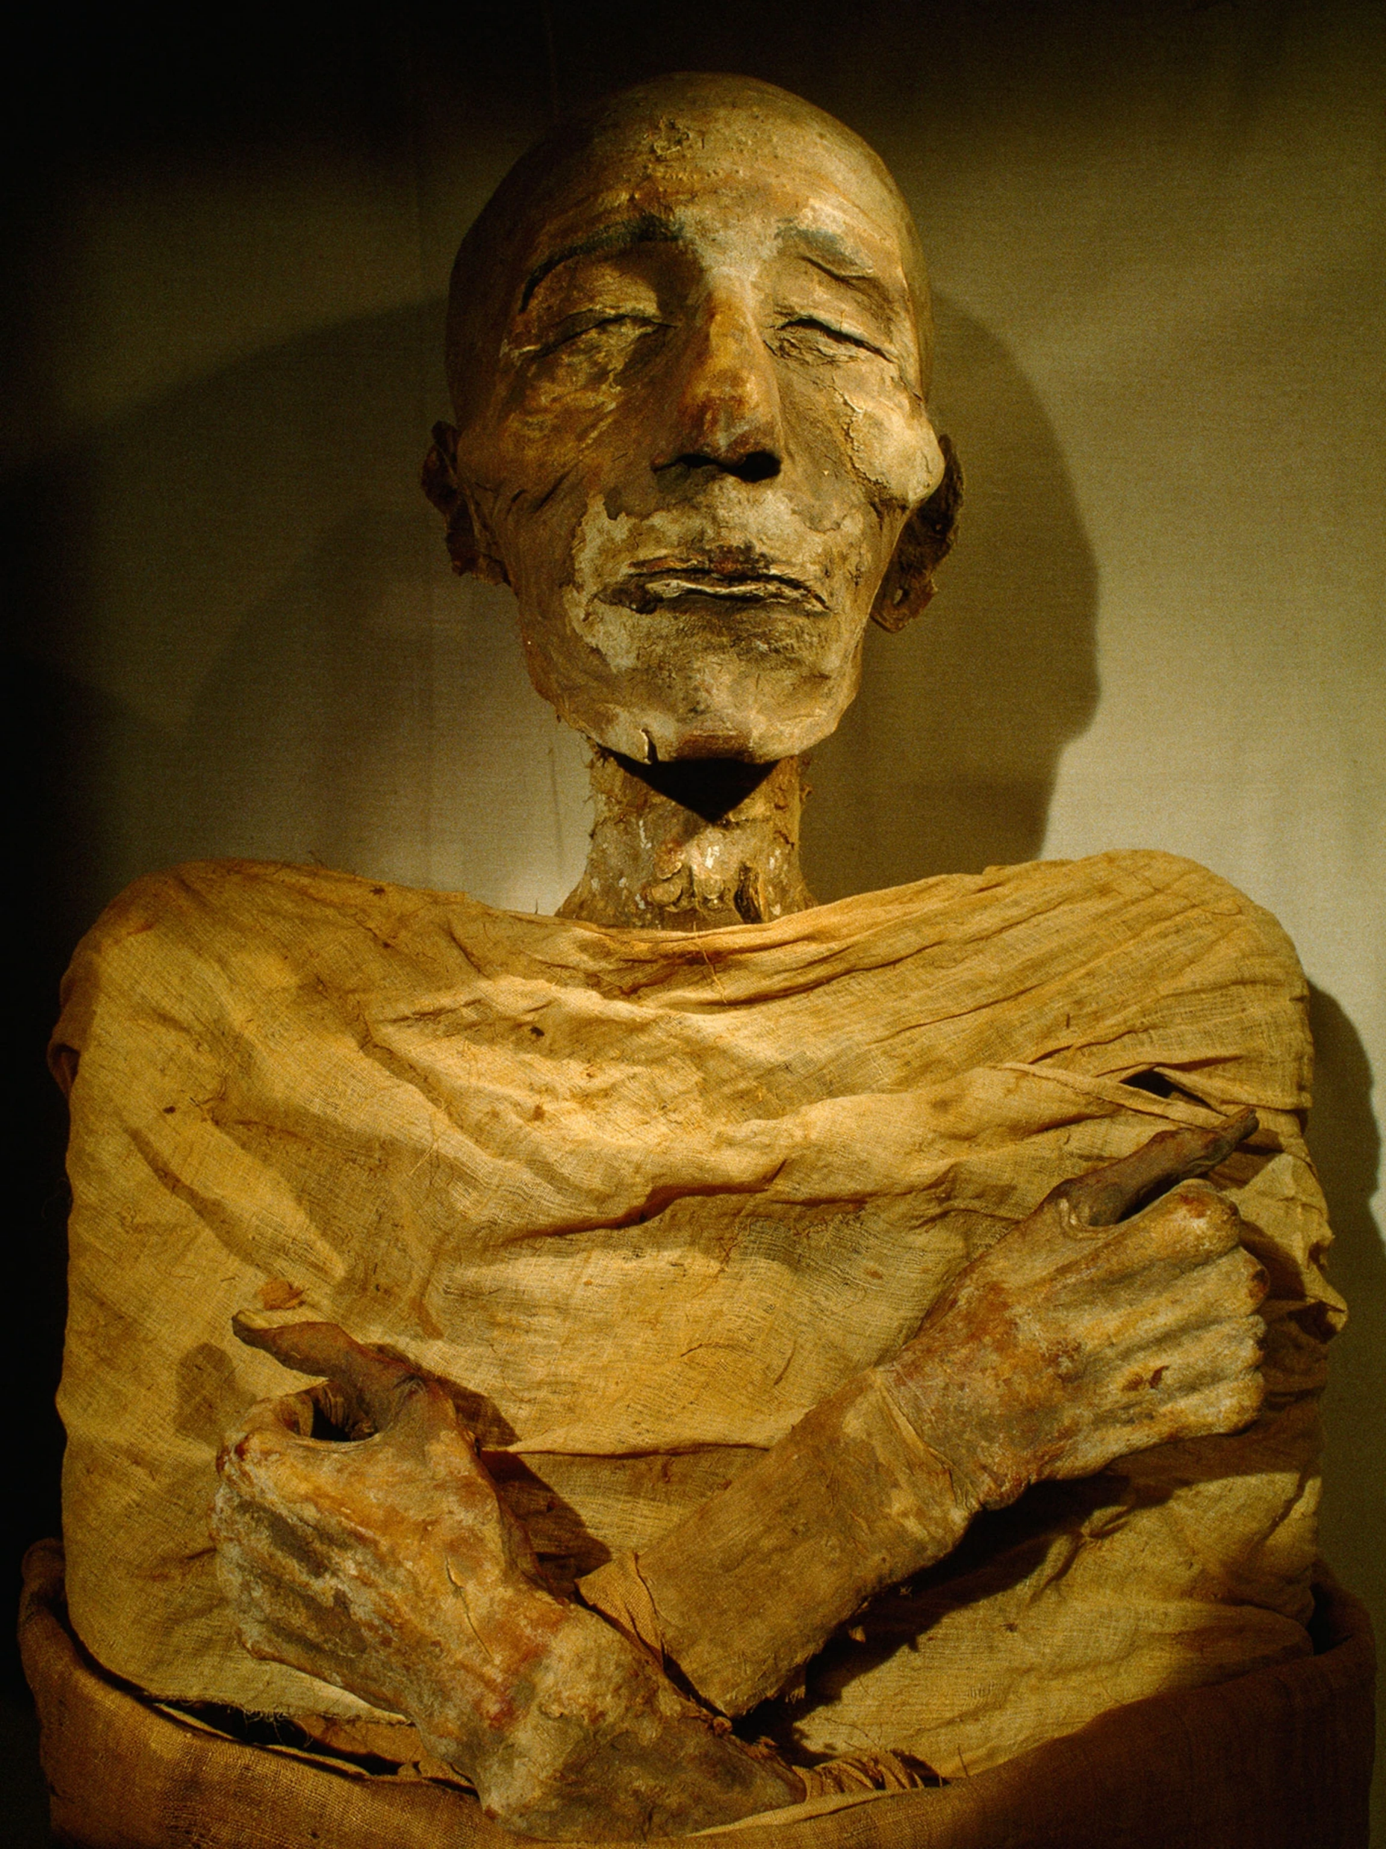
Preserving the Body
Once we have the internal organs removed, we can go about preserving the rest of the body.
Step 4: Salting your Mummy
Egyptians liked their mummies heavily seasoned and stuffed, just like a good thanksgiving turkey. They used a special salt called Natron to preserve the body. This helped remove any moisture from the skin and killed any remaining bacteria. We will first start by packing the mummy’s empty cavity with Natron. For our purposes we will be using sand bags.
After this, Egyptians would leave mummies in a salt bath for 30 days. Since we don’t have that much time, you can recreate this step by giving your mummy a heavy seasoning of salt from the salt shaker!

Slide 6
Preparing for Burial
As you can imagine, after 30 days of pickling in salt, a human body does not smell particularly pleasant. In order to prepare our mummy for its final burial we will need to solve this and make the body presentable!
Step 5: Give your Mummy an Exfoliating Massage
The final step in treating the body is to massage it with a special blend of oils that help with the final step of preservation. The nice advantage of these oils is that they will also leave the mummy with a pleasant scent. Go ahead and rub your mummy from head to toe with oil.
Step 6: Wrapping the Mummy
The final step of preparation involves wrapping our mummy in linen to seal it from the elements. During this step, priests would often include amulets meant to help the mummy in the afterlife.

Slide 7
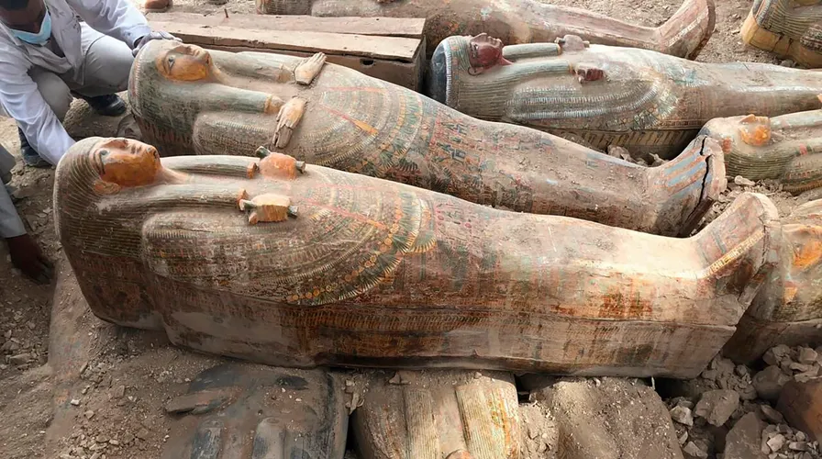
Placing Inside the Sarcophagus
We have now reached the end of the mummification process. After over a month of work, our mummy is now ready to be placed in his sarcophagus and sent off to face his final judgement.
Step 7: Place the Sarcophagus
You will see that we have several sarcophagi spread around the desert. Go ahead and grab one that you feel fits your needs, and place it over your mummy on the table.

