Slide 1
America Enters The World Stage: |The Monroe Doctrine|
A James Monroe Museum
Virtual Exhibit

Slide 2
|Introduction|
When James Monroe became President in 1817, he had already served as an ambassador to France, negotiated the Louisiana Purchase, and served as Secretary of State during the War of 1812.
America was expanding, both in size and in influence, and a new American identity was being formed after the war.
Monroe made significant contributions to American foreign policy throughout this life, most notably through the Monroe Doctrine.

Slide 3
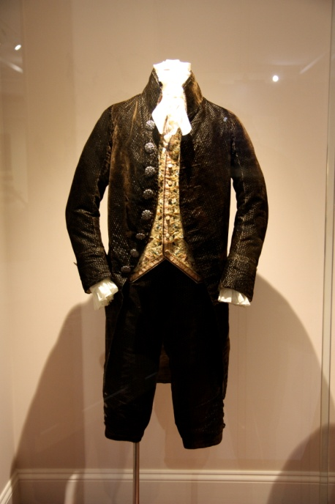
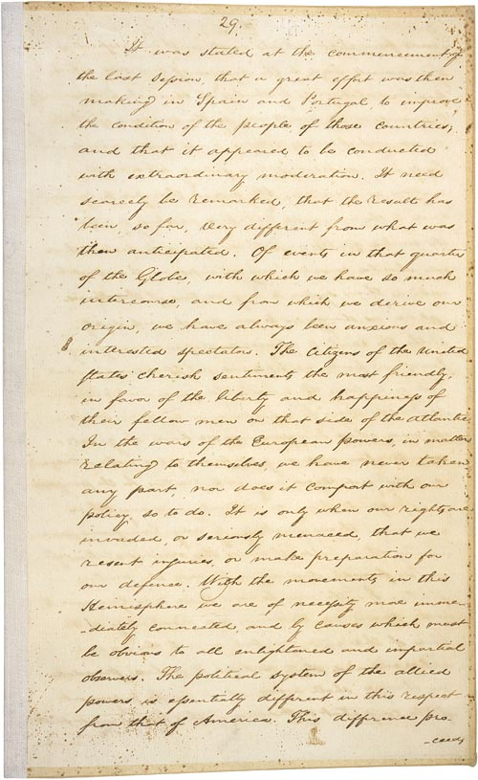
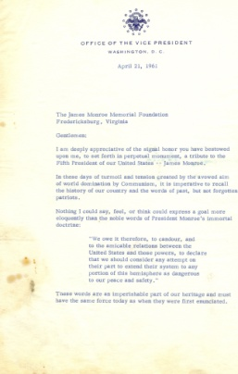
|The Exhibits|
The Monroes in Paris
The Monroe Doctrine
The Doctrine’s Legacy
Click an Object to Enter
Notes:
Tiara picture will change

Slide 4
|The Monroes in Paris|
{1794-1796}
The Monroes represented all of America when
they were ambassadors in Europe, at a time when an American identity was still forming.
What did they seek to convey through their appearances?

Slide 5
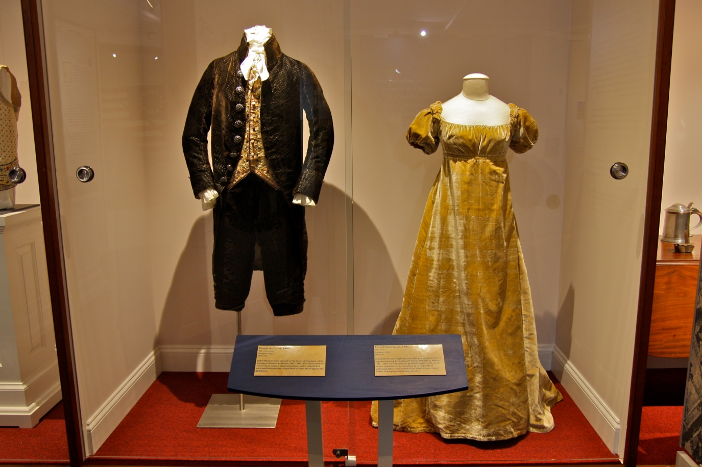
|The Monroes in Paris|
James Monroe wore this three-piece court suit decorated with nine ornate steel buttons, faceted to give the illusion of brilliant stones.
JM76.219
Elizabeth Monroe wore this fawn-colored silk velvet dress to the coronation. Its empire style was popular during the French court of Napoleon I.
JM.76.240

Slide 6
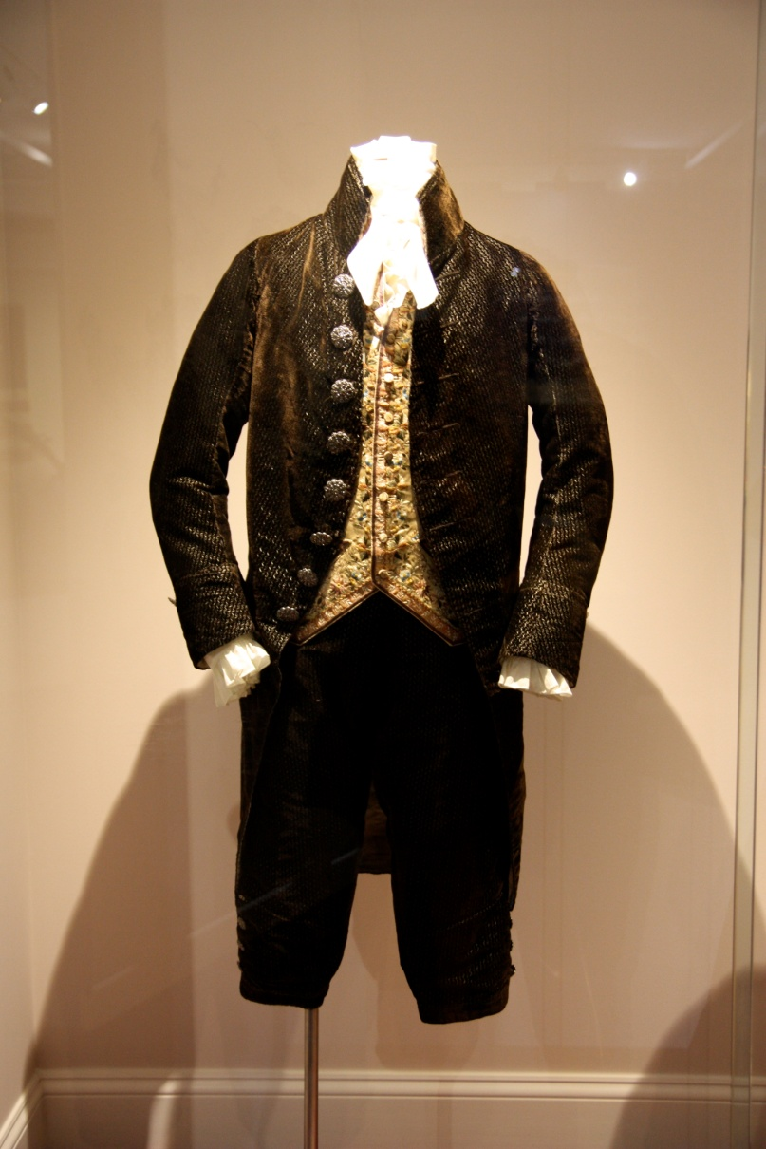
|The Monroes in Paris|
What do you think the Monroes were trying to communicate with their clothes? How would you describe their appearance?

Slide 7
|The Monroes in Paris|
The way the Monroes dressed in Paris was intentional and designed to assist them in presenting a favorable view of America to aid in ambassadorial responsibilities.

Slide 8
|The Exhibits|
The Monroes in Paris
The Monroe Doctrine
The Doctrine’s Legacy
Click an Object to Enter
Notes:
Tiara picture will change

Slide 9
|The Monroe Doctrine|
In his seventh annual address to Congress on
December 2, 1823, President Monroe first
articulated the Monroe Doctrine, declaring that
European powers must respect the Western
Hemisphere as the United States’ “sphere of
influence.”
What was the context of the Monroe Doctrine and how did it impact the United States’ relations with the world?

Slide 10
|The Monroe Doctrine|
“…as a principle in which the rights and interests of the United States are involved, the American continents, by the free and independent condition which they have assumed and maintain, are henceforth not to be considered as subjects for future colonization by any European powers...”

Slide 11
|Reading Primary Sources|
What was Monroe declaring to the world?

Slide 12
|The Monroe Doctrine|
Did the Monroe Doctrine change the way America was viewed by other countries? If so, how?
Did Europeans take the Monroe Doctrine and America as a nation seriously?
Was it possible for America to be isolated during the early Republic?

Slide 13
|The Monroe Doctrine|
The Monroe Doctrine became a foundation piece of American foreign policy and helped solidify a new American identity to the world. In declaring the Western Hemisphere unavailable to European interference, it also warned that the United States would interpret any foreign involvement there as aggression.
The immediate purpose of the doctrine was to defend the U.S.’s interests in its closest neighbors. But because of this, other nations in the Western Hemisphere and elsewhere have not always regarded the doctrine favorably.

Slide 14
|The Exhibits|
The Monroes in Paris
The Monroe Doctrine
The Doctrine’s Legacy
Click an Object to Enter
Notes:
Tiara picture will change

Slide 15
|The Legacy of the Monroe Doctrine|
Since Monroe’s presidency, the Monroe Doctrine has become central to America’s foreign policy. However, it hasn’t always been interpreted the same way.
How has the Monroe Doctrine been applied and interpreted throughout American history?

Slide 16
|The Legacy of the Monroe Doctrine|
Applications of the Monroe Doctrine:
1864: Napoleon III’s invasion of Mexico
1870: US declares authority to mediate South American border disputes
1904: The Roosevelt Corollary
1962: Communism in Cuba- Kennedy and the Cuban Missile Crisis
1980s: US involvement in civil wars in El Salvador and Nicaragua
2003: “Bush Corollary”: Iraq invasion

Slide 17
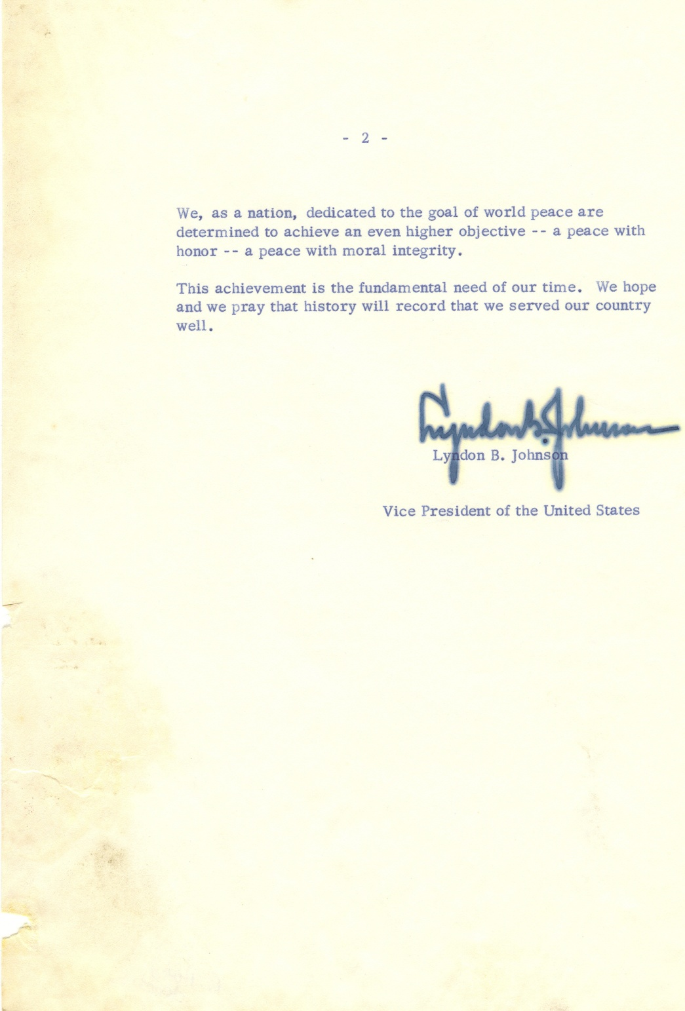

Slide 18
|Reading Primary Sources|
How did Johnson view the Monroe Doctrine?
How do you think Johnson and President Kennedy applied the Monroe Doctrine to their times?

Slide 19
|Questions for Discussion|
How have future Presidents used and interpreted the Monroe Doctrine?
Which applications of the Monroe Doctrine do you agree with? With which do you disagree?
Do you think invoking the Monroe Doctrine with reference to Communism in the 1960s is an appropriate interpretation of Monroe’s statements?

Slide 20
|The Legacy of the Monroe Doctrine|
From its beginnings, the interpretation of the Monroe Doctrine has been complex and at times controversial. Nevertheless, the document has been and remains central to American foreign policy and has been invoked at significant points in U.S. history, from the South American border disputes to modern conflicts in the Middle East.

