Slide 1
Analyzing Data from the First Industrial Revolution: A Statistical Approach

Slide 2
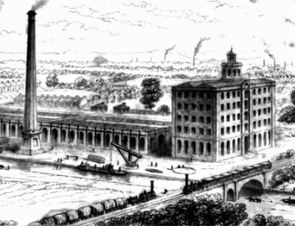
Lesson Goals
Today, you won’t read a story — you’ll read charts, graphs, and statistics.
You’ll look at how things changed: population, production, and more.
Your job: Figure out what the numbers reveal.
Notes:
Today, you won’t read a story — you’ll read charts, graphs, and statistics. You’ll look at how things changed: population, production, wages, health, and more. Your job is to figure out what the numbers reveal. By analyzing the data, you will gain insights into significant trends and developments over time.

Slide 3
Understanding Historical Data Types
Different forms of statistical evidence:
Population Graphs
Manufacturing Charts
Education Data
Why data matters: Provides concrete evidence of historical changes.
Key skill: Converting raw numbers into meaningful insights.

Slide 4
Drawing Evidence-Based Conclusions
Steps for analyzing historical data:
Identify the type of data
Note the time period and location
Look for patterns and trends
Consider causes and effects
Support conclusions with specific numbers
Common pitfalls to avoid:
Making assumptions without evidence
Ignoring contextual factors
Misinterpreting scales and units

Slide 5
Data Analysis
Questions to consider when doing Data Analysis:
What changed the most dramatically?
Which changes happened fastest?
What patterns suggest cause and effect?
Remember: Always cite specific numbers to support your claims

Slide 6
Data Presentations Examples of the Industrial Revolution
Common data presentations:
Graphs showing production changes
Bar charts comparing output between regions
Percentage increases over time as shown in charts
Important factors to consider:
Scale of measurement
Timeframes
Regional variations
Practice question: "If coal production doubled every 20 years, how many times more would it be after 60 years?"
Answer: It would be 8 times more (doubled 3 times: 2 → 4 → 8)

Slide 7
Thematic Data Review
Review and take notes to help analyze each graph and chart related to the Industrial Revolution.

Slide 8
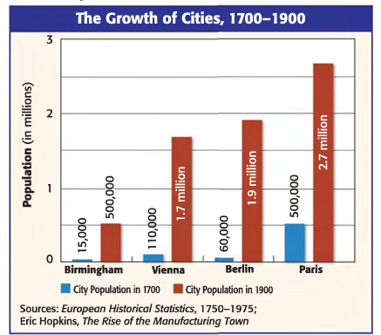
Population and Urban Growth
Review both axis ( y and x), the key, and the title to determine what the graph is conveying.
Analyze these components of the graph:
The size of the populations both represented before and after the Industrial Revolution.
Which cities were the most and least populated in both time frames.

Slide 9
Production and Manufacturing
Share of total world manufacturing output (percentage)
 | 1750 | 1800 | 1860 | 1880 | 1900
Europe | 23.2 | 28.1 | 53.2 | 61.3 | 62.0
United States | 0.1 | 0.8 | 7.2 | 14.7 | 23.6
Japan | 3.8 | 3.5 | 2.6 | 2.4 | 2.4
Rest of the world | 73.0 | 67.7 | 36.6 | 20.9 | 11.0
Review the columns, rows, and the title of the chart to determine what topic the information represents.
Analyze these components of the graph:
Determine the growth or decline of each country's manufacturing output.
Which increased?
Which declined?
Compare the rates of change.
Which regions changed the most?

Slide 10
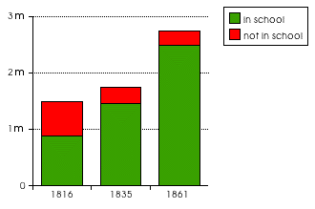
Education
School Enrollments in Britain
Review both axis ( y and x), the key, and the title to determine what the graph is conveying.
Analyze these components of the graph:
What do the green and red bars represent?
What trend do you see in the number of children attending school vs. not attending school?
Amount of people in Millions

Slide 11
Review your Analysis
Once you review your notes and reflections about each of the graphs, prepare for the Section Test.

